Slide 1
Design Update #2
Joshua thao, Jonathan benusa, jack schumacher

Slide 2
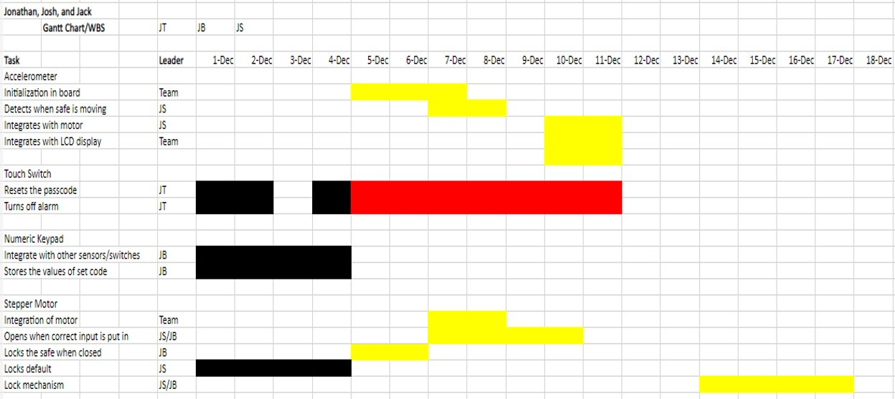
WBS/GANTT Chart for last/this week Part I

Slide 3
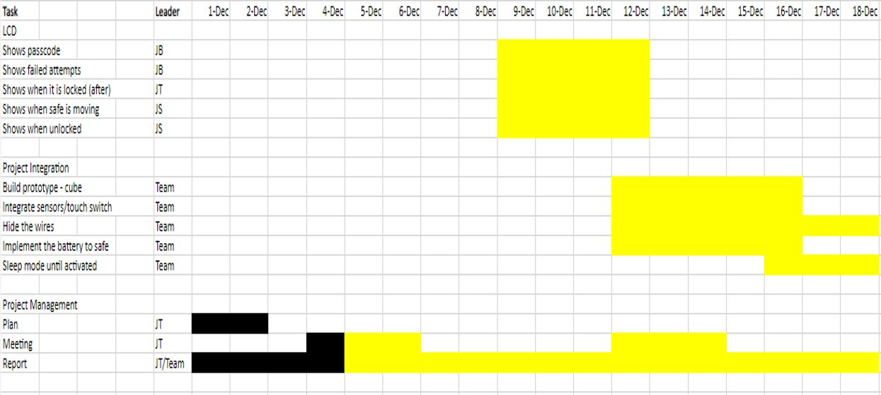
WBS/GANTT Chart for last/this week Part II

Slide 4
Outcomes
LCD
Most of the LCD displays for the code have been created by Jack and Jonathan.
Stepper Motor
Jack has stepper motor prepared, just need to create lock mechanism

Slide 5
Shortcomings
Touch Button code is still a work in progress, having problems making the button work as an input
Initialization of the Accelerometer is taking longer than expected

Slide 6
Plans Onward (This week)
Accelerometer:
Begin initializing as Team
Implement function in board (after initializing)
Touch Switch
Initialize and code the proper functions of the switch
Motor/Numeric Keypad integration
Project Integration:
Dedicate whole week to begin building prototype
Project Management:
Fill in technical report/power budget analysis

Slide 7
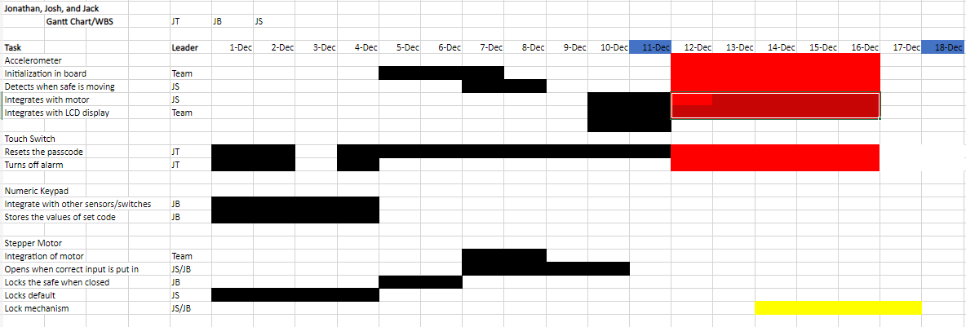
WBS/Gantt Chart (Plans Onward)

Slide 8
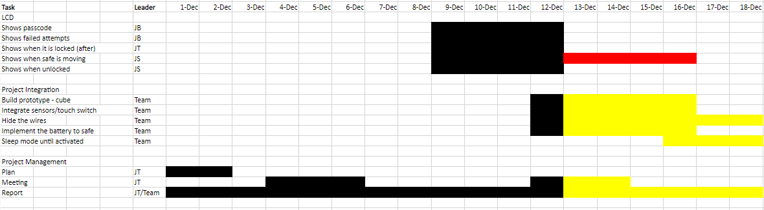
WBS/Gantt Chart (Plans Onward)

